Slide 1
Functions
f(x)
SoftUni Team
Technical Trainers
Software University
http://softuni.bg

Slide 2
Table of Content
What is a Function?
Declaring/Invoking Functions
Arrow Functions
Nested Functions
Reference vs Value Types
Naming and Best Practices

Slide 3
Have a Question?
sli.do
#fund-js

Slide 4

Functions Overview
Declaring and Invoking Functions

Slide 5
Functions in JS
A function is a subprogram designed to perform a particular task
Functions are executed when they are called. This is known as invoking a function
Values can be passed into functions and used within the function
Use camel-case
Parameter
function printStars(count) {
console.log("*".repeat(count));
}

Slide 6
Why Use Functions?
More manageable programming
Splits large problems into small pieces
Better organization of the program
Improves code readability and understandability
Avoiding repeating code
Improves code maintainability
Code reusability
Using existing functions several times

Slide 7
Function without Parameters
Executes the code between the brackets
function multiplyNumbers() {
let result = 5 * 5;
console.log(result);
}
multiplyNumbers(); // Expected Output: 25
Prints result on the console

Slide 8
{…}
Declaring and Invoking Functions
Notes:
Add Image!

Slide 9
Declaring Function
Functions can have several parameters
Functions always return a value (custom or default)
Parameters
Name
function printText(text){
console.log(text);
}
Body

Slide 10
Declaring Function
Functions can be declared in several ways:
Function declaration
Function expression
Function constructor
function printText(text){
console.log(text);
}
var printText = function(text){
console.log(text);
}
new Function(‘text’, ‘console.log(text);’);

Slide 11
Invoking a Function
Functions are first declared, then invoked (many times)
Functions can be invoked (called) by their name
function printHeader(){
console.log("----------");
}
Function Declaration
function main(){
printHeader();
}
Function Invocation

Slide 12
Invoking a Function (2)
A function can be invoked from:
Other functions
Itself (recursion)
function printHeader() {
printHeaderTop();
printHeaderBottom();
}
Function invoking functions
function crash() {
crash();
}
Function invoking itself

Slide 13
Invoking a Function (3)
A function can be invoked in several ways
Function invocation – alert(‘Hello World!’);
Method invocation – console.log(‘Hello World!’);
Constructor invocation – new Car(‘Renault’);
Indirect invocation – greet.call(student);
function greet() {
return ‘Hello ’ + this.name;
}

Slide 14
Problem : Grades
Write a function that receives a grade a grade between 2.00 and 6.00 and prints the corresponding grade in words
Between 2.00 and 2.99 - 'Fail'
Between 3.00 and 3.49 - 'Poor'
Between 3.50 and 4.49 - 'Good'
Between 4.50 and 5.49 – 'Very good'
Between 5.50 and 6.00 - 'Excellent'

Slide 15
Solution: Grades
function solve(grade) {
if (grade >= 2.00 && grade <= 2.99) {
return 'Fail';
} else if (grade >= 3.00 && grade <= 3.49) {
return 'Poor';
}
// TODO: Add other conditions
}
Check your solution here: https://judge.softuni.bg/Contests/1230/Functions-Lab

Slide 16
Problem : Math power
Create a function that calculates the value of a number
The number should be raised to a given power
Return its value
Input
Output
2, 8
256
3, 4
81

Slide 17
Solution: Grades
function solve(num, power){ let pow = 1; // loop exponent times
for(let i = 0; i < power; i++){
//multiply the base value
pow = pow * num;
}
return pow;
}
Check your solution here: https://judge.softuni.bg/Contests/1230/Functions-Lab

Slide 18
() => {}
Arrow Functions

Slide 19
Arrow Functions
These are functions with their own special syntax
They accept a fixed number of arguments
They operate in the context of their enclosing scope
let increment = x => x + 1;
console.log(increment(5)); // 6
"=>" (arrow)
let increment = function(x) {
return x + 1;
}
This is the same as the function above
let sum = (a, b) => a + b;
console.log(sum(5, 6)); // 11

Slide 20
Problem: Simple Calculator
Write a function that receives three parameters and write an arrow function, that calculates a result depending on operator
The operator can be 'multiply', 'divide', 'add', 'subtract'
The input comes as three parameters - two numbers and an operator as a string
Input
Output
5, 10, 'multiply'
25

Slide 21
Solution: Simple Calculator
function solve(a, b, operator) {
switch (operator) {
case 'multiply':
let multiply = (a, b) => a * b;
console.log(multiply(a, b));
break;
case 'divide':
//TODO: Divide the two numbers
case 'add':
//TODO: Add the two numbers
case 'subtract':
//TODO: Subtract the two numbers
}
}
Check your solution here: https://judge.softuni.bg/Contests/1230/Functions-Lab

Slide 22
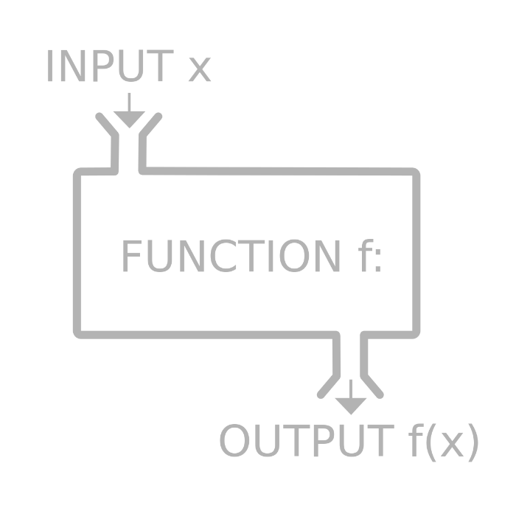
Nested Functions

Slide 23
Nested Functions: Example
Functions in can be nested, i.e. hold other functions
Inner functions have access to variables from their parent
Main function
function drawDiamond(size) {
drawTop(size / 2)
drawBottom(size / 2)
}
Nesting the functions

Slide 24
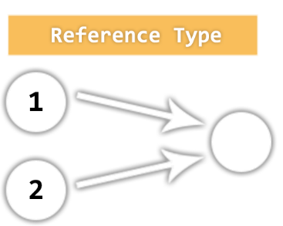
Value vs. Reference Types
Memory Stack and Heap

Slide 25
Reference vs. Value Types
JavaScript has 5 data types that are copied by value:
Boolean, String, Number, null, undefined
These are primitive types
JavaScript has 3 data types that are copied by having their reference copied:
Array, Objects and Functions
These are all technically Objects, so we'll refer to them collectively as Objects

Slide 26
Example: Reference vs. Value Types

Slide 27
Value Types
If a primitive type is assigned to a variable, we can think of that variable as containing the primitive value
They are copied by value
let a = 10; let c = a; let b = 'abc'; let d = b;
console.log(a, b, c, d); // a = 10 b = 'abc' c = 10 d = 'abc'

Slide 28
Reference Types
Variables that are assigned a non-primitive value are given a reference to that value.
That reference points to a location in memory
Variables don't actually contain the value but lead to the location
let arr = []; let arrCopy = arr;

Slide 29

Naming and Best Practices

Slide 30
Naming Functions
Use meaningful names
Should be in camelCase
Names should answer the question:
What does this function do?
If you cannot find a good name for a function, think about whether it has a clear intent
Self explaining
findStudent, loadReport, sine
Puzzling
Method1, DoSomething, handleStuff, DirtyHack

Slide 31
Naming Function Parameters
Function parameters names
Preferred form: [Noun] or [Adjective] + [Noun]
Should be in camelCase
Should be meaningful
Unit of measure should be obvious
firstName, report, speedKmH, usersList, fontSizeInPixels, font
p, p1, p2, populate, LastName, last_name, convertImage

Slide 32
Functions - Best Practices
Each function should perform a single, well-defined task
A name should describe that task in a clear and non-ambiguous way
Avoid functions longer than one screen
Split them to several shorter functions
function printReceipt(){
printHeader();
printBody();
printFooter();
}
Self documenting and easy to test

Slide 33
Code Structure and Code Formatting
Make sure to use correct indentation
Leave a blank line between functions, after loops and after if statements
Always use curly brackets for loops and if statements bodies
Avoid long lines and complex expressions
function Mian()
{
// some bad
// example code…
}
function main() {
// some good…
// example code…
}

Slide 34

Summary
…
…
…
Functions:
Break large programs into simple functions that solve small sub-problems
Consist of declaration and body
Are invoked by their name
Can accept parameters

Slide 35
https://softuni.bg/courses/programming-fundamentals

Slide 36












SoftUni Diamond Partners

Slide 37




SoftUni Organizational Partners

Slide 38




Trainings @ Software University (SoftUni)
Software University - High-Quality Education and Employment Opportunities
softuni.bg
Software University Foundation
http://softuni.foundation/
Software University @ Facebook
facebook.com/SoftwareUniversity
Software University Forums
forum.softuni.bg

Slide 39

License
This course (slides, examples, demos, videos, homework, etc.) is licensed under the "Creative Commons Attribution-NonCommercial-ShareAlike 4.0 International" license

